Slide 1
E-Commerce Data Analysis
Team 8

Slide 2
Introduction
Problem Setup
Dataset Description and EDA
K-Means Clustering
Decision Tree Analysis

Slide 3

Problem Setup
Loaded into Pentaho where CSVs were used in Jupyter
Conducted an EDA to get a proper feel of the data
Cleaned data to allow for reasonable analysis
Conducted analysis with K-means and Decision Tree

Slide 4
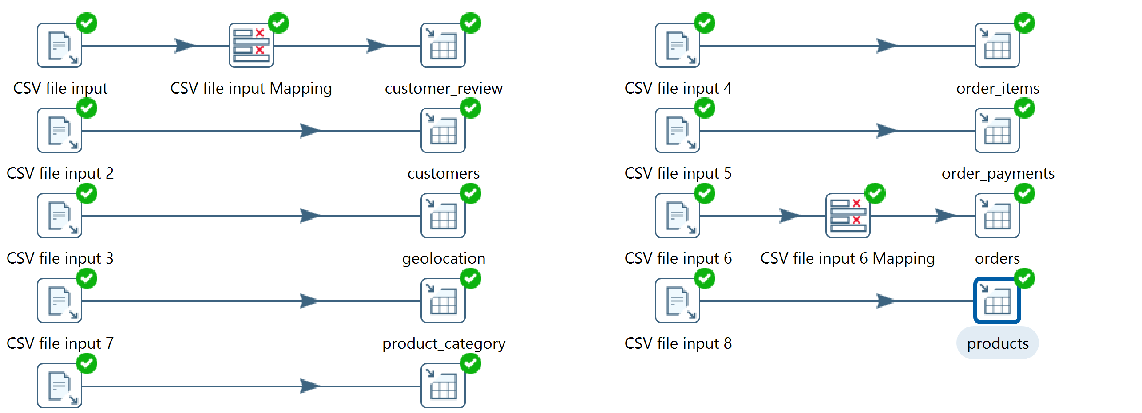
ETL
Notes:
So in terms of the beginning data transfer over.

Slide 5

Dataset Description
Notes:
So, the dataset we used was the E-commerce data. There were several hundred thousand of rows of data, all of which pertaining to e-commerce products, how they rated, customer data, and product data. The data was also originally in Spanish too oddly enough. Unfortunately, much of the data was in string due to the categorical nature of it, making it unusable for our analysis, but we found ways to interpret or transfer that data for proper analysis. Further along in the presentation I’ll be covering that. In terms of outliers we used 3-Sigma from the mean as that would cover the bulk of the data while trimming away at the strong deviances.

Slide 6
Highest 5-Star Count

Slide 7
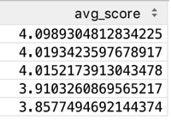
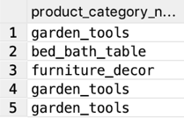
Top 5 Products Averaged

Slide 8
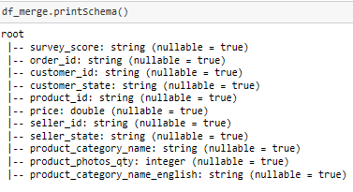
EDA
Notes:
So to begin, in looking at the schema of the dataframe of the columns, you will see many of them are string as stated previously. Due to this, they cannot really be used without being an integer or a double. So one of the first things we did was to transfer the type of survey_score from string to integer so it would be usable. From there, we looked to see what the correlations looked like for those columns that were usable.

Slide 9
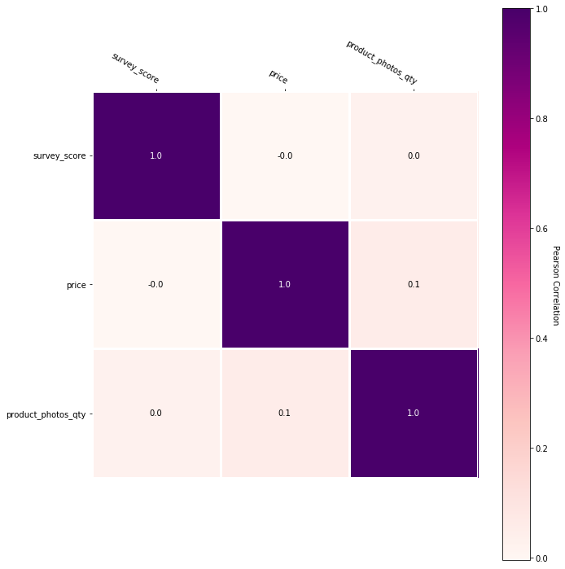
EDA
Notes:
So, as you can see in the correlation chart the correlations for all variables, besides to themselves, are all very low with either .1 or lower indicating they will be available for use in the k-means. The categorical variables were unnecessary and not considered. The correlations would skew K-means results and our exploration proved fruitful.

Slide 10
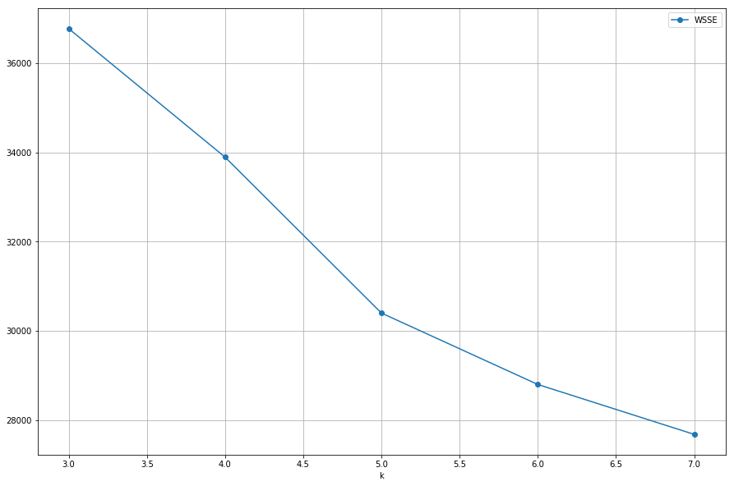
K-Means: Elbow Plot
Notes:
To calculate our K-value in the K-means clustering, we ran an elbow plot. As you can see in the graph, following 5, the slope begins to flatten out meaning we should stick with that number for our K-value. Input for the Elbow Plot’s Y-Axis, the WSSE was used as it can evaluate the level of clusters necessary before diminishing returns sets in. Much to the name, the prominent elbow makes it obvious which number K should be, which is 5.

Slide 11
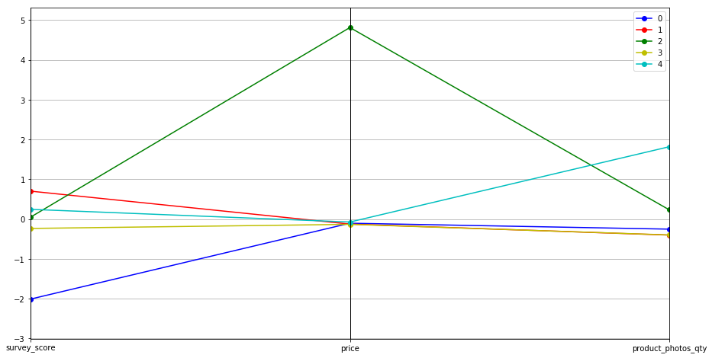
K-Means Clusters
Notes:
So in looking at our 5 clusters, they’ve evaluated on a scale on where they stand in terms of the survey score, price, and photo quantity. Based upon a conducted centroid prediction and the cluster plot, the red line, cluster 1, is the largest cluster which contains the highest survey score, a normal price and relatively lower photo quantities. The smallest cluster is seen with cluster #2 with the green line that contains a significantly higher price, a normal survey score and normal photo quantity. In terms of actionable insights derived from the K-means, cluster number 2, the green line, presents itself as an avenue of profit for e-commerce related companies that launch higher priced or premium products, so marketing these expensive products toward that group would be beneficial. Finally, another action to take would also be to investigate the product line that makes up cluster number 0, seeing as their survey score is significantly lower than normal there is obviously room for improvement.

Slide 12
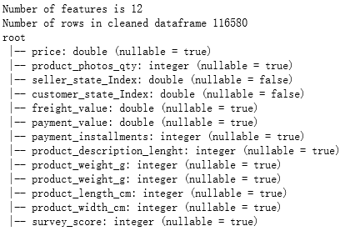
Decision Tree Classification
Notes:
To begin with, in terms of the classification portion, we identified 12 features to use in this process. In calculating which columns were necessary, we once again used correlations, landing upon these 12. If you remember in the previous schema output, many of the columns are string, and therefore unusable. To fix this, we used the onehot encoder and string indexer to transfer the unusable data into either a double or integer for usable content.

Slide 13
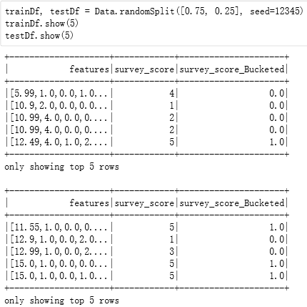
Decision Tree Model: Preparation
Notes:
To create input data for our decision tree model, our team used a randomsplit which accounted for 75% of the data for testing and prediction use.

Slide 14
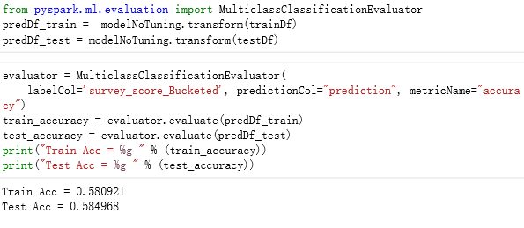
Decision Tree Model Output
Notes:
So, in running everything and allowing the full decision tree model to run, we calculated the following output of the train dataframe accuracy of 58% where the Test accuracy come out to 58.5%. So what does this actually translate to? Essentially it means that through the randomized split of the data we loaded and cleaned, our model was able to predict 58.5% of the data accurately as evaluated by the multi classification evaluator.

Slide 15
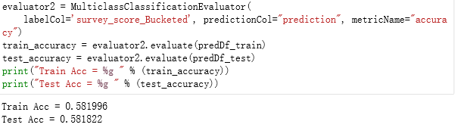
Gradient-boosted Tree Classifier
Notes:
To ensure the accuracy of the previous decision tree, we also ran a gradient boosted tree classifier which ended up with an almost exact output, cementing our results as solid.

Slide 16
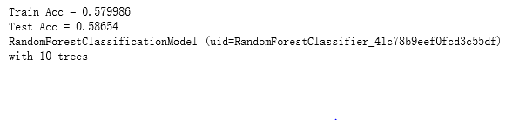
Random Forest Classification
Notes:
To triple check, we also took the air of caution and conducted a random forest classification, finding once again that our output was the correct result for our model.

Slide 17
Conclusion
K-means
3 variables: price, survey_score, product_photo_qty
5 clusters
WSSE~=30,000
Classification with Decision Tree Model
12 variables
Depth:5
Nodes:63
Ensured with gradient tree model and random forest
Cluster 2 can be marketed for high price
Cluster 0 has low scoring products
Successfully predicted 58.5% of the data
Notes:
So, in conclusion we found in our K-means analysis that: 3-variables were uncorrelated and usable for our cluster analysis. We arrived at 5 clusters and found a weighted SSE of roughly 30000 from choosing our K as 5. In terms of our classification with the decision tree model, we identified 12 features with a depth of 5 and 63 nodes.

Slide 18
Q & A

